Slide 1
Web Development

Slide 2
Content
Browser Engine
DOM(Document object model)
Meta and Viewport
Flex
Equality

Slide 3
Browser Engine
A browser engine is a core software component of every major web browser. The primary job of a browser engine is to transform HTML documents and other resources of a web page into an interactive visual representation on a user's device.

Slide 4

Browser Engine

Slide 5
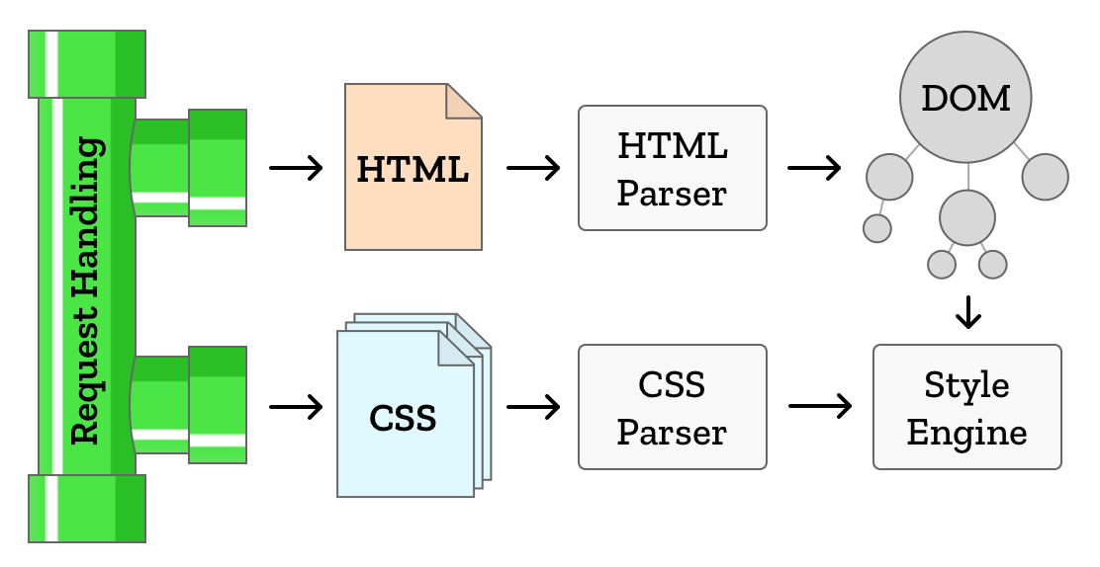
Browser Engine

Slide 6
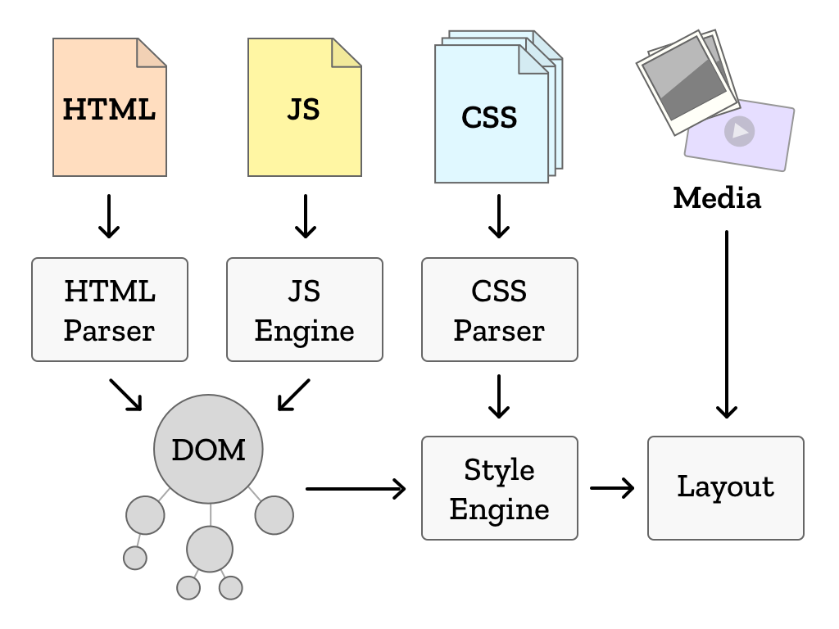
Browser Engine

Slide 7
Browser Engine
The browser engines that are used by web browsers:
Blink – Chrome
WebKit – Safari
Gecko – Firefox
Trident – Internet Explorer
EdgeHTML - Edge

Slide 8
DOM(Document Object Model)
The Document Object Model (DOM) is a programming API for HTML and XML documents. It defines the logical structure of documents and the way a document is accessed and manipulated.

Slide 9
DOM(Document Object Model)

Slide 10
Meta Tag
The <meta> tag defines metadata about an HTML document. Metadata is data (information) about data.
<meta> tags always go inside the <head> element, and are typically used to specify character set, page description, keywords, author of the document, and viewport settings.

Slide 11
Meta Tag
Examples of using meta tag:
Define keywords for search engines:
<meta name="keywords" content="HTML, CSS, JavaScript">
Define a description of your web page:
<meta name="description" content="Free Web tutorials for HTML and CSS">
Define the author of a page:
<meta name="author" content="John Doe">
Specifies the character encoding for the HTML document
<meta charset="UTF-8">
Setting the viewport to make your website look good on all devices:
<meta name="viewport" content="width=device-width, initial-scale=1.0">

Slide 12


Viewport
Without Viewport
With Viewport

Slide 13
Flex
The Flexible Box Module, usually referred to as flexbox, was designed as a one-dimensional layout model, and as a method that could offer space distribution between items in an interface.

Slide 14
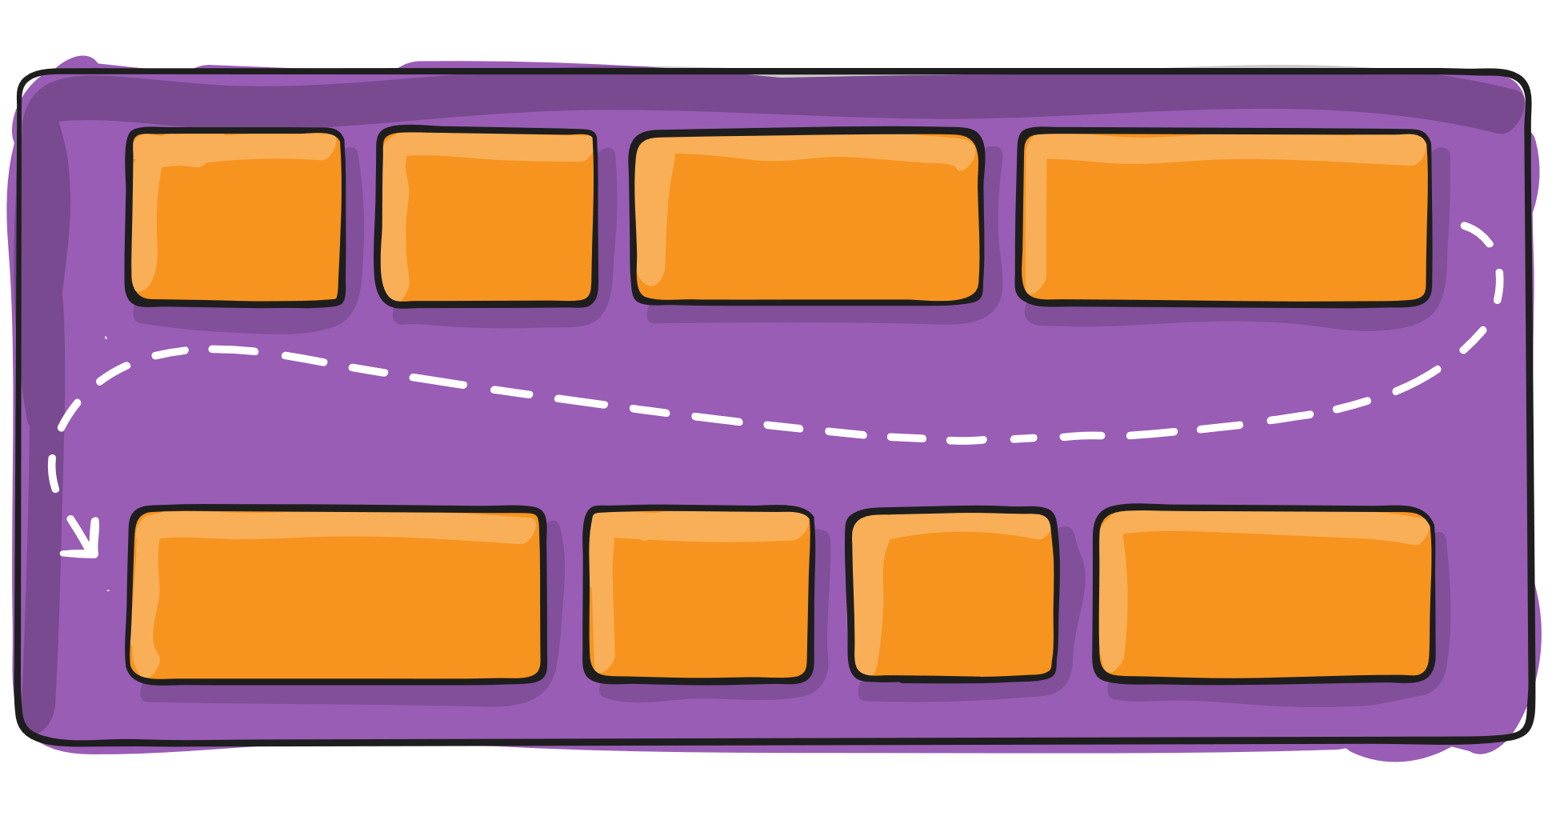
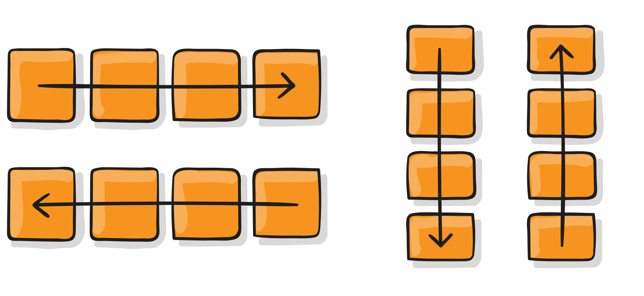
Flex
Flex Direction
Flex wrap

Slide 15
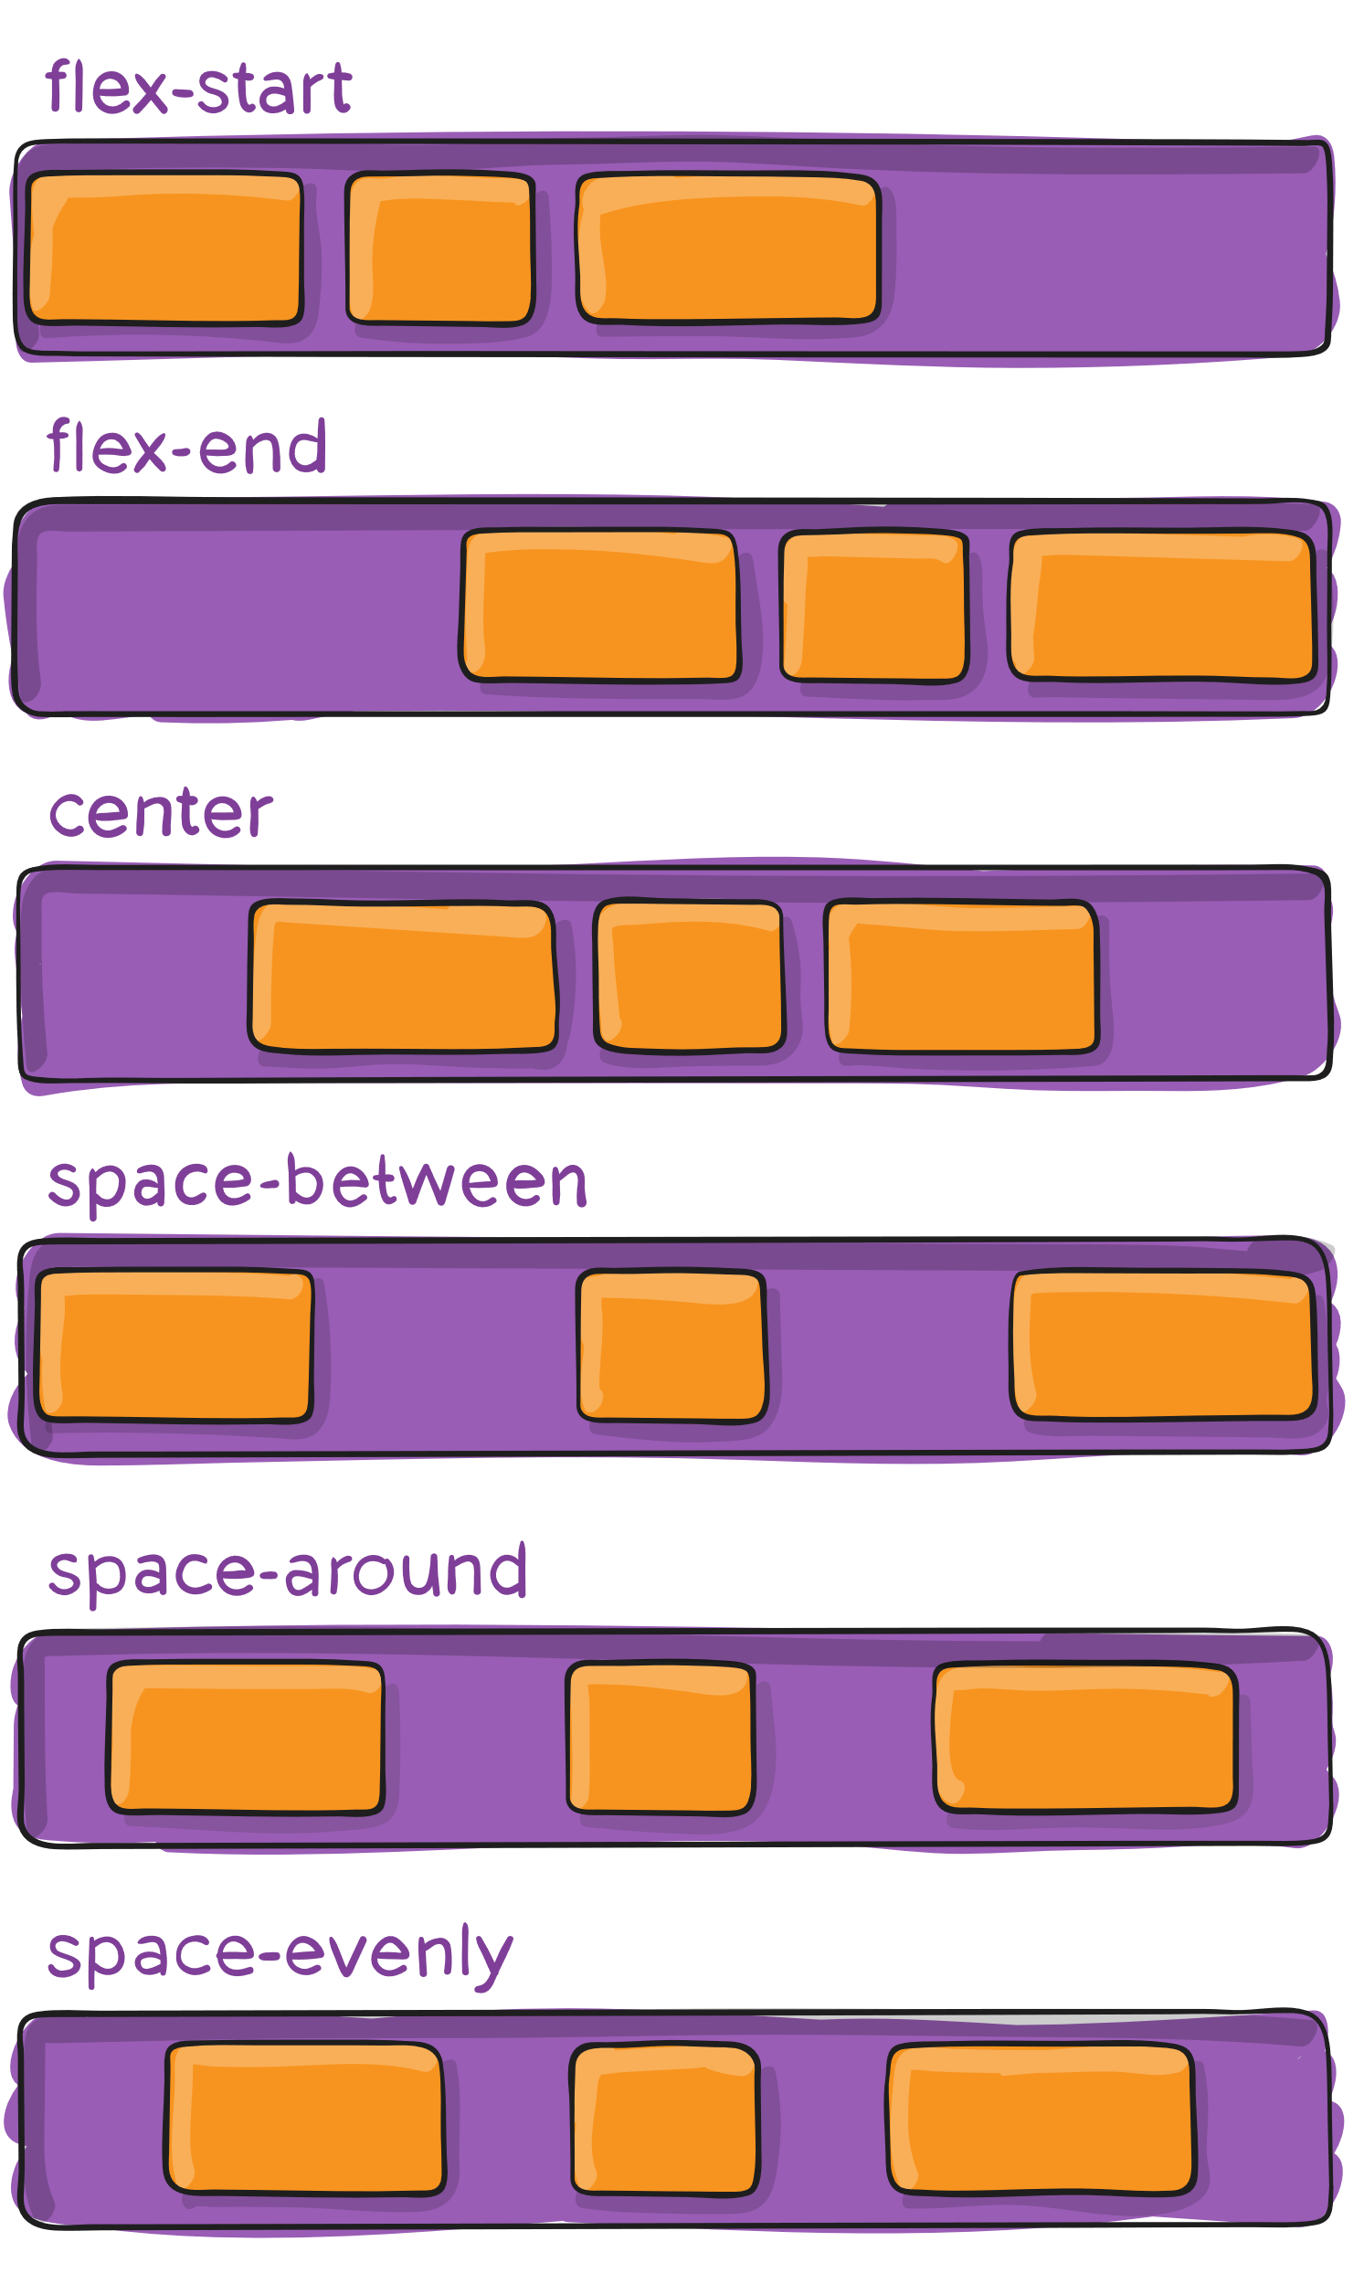
Flex
Justify-content

Slide 16
Equality
Loosely Equal
Strictly Equal
The loose equality operator '==' allows us to compare two or more operands by converting their value to a common type first and then checking for the equality between them.
Ex: console.log(0 == ‘0’); // true
strict equality operator '===' allows us to compare two or more operands by checking the equality between the values as well as their types.
Ex: console.log(0 === ‘0’); // false

